Slide 1
RulesCard Storyboarding

Slide 2
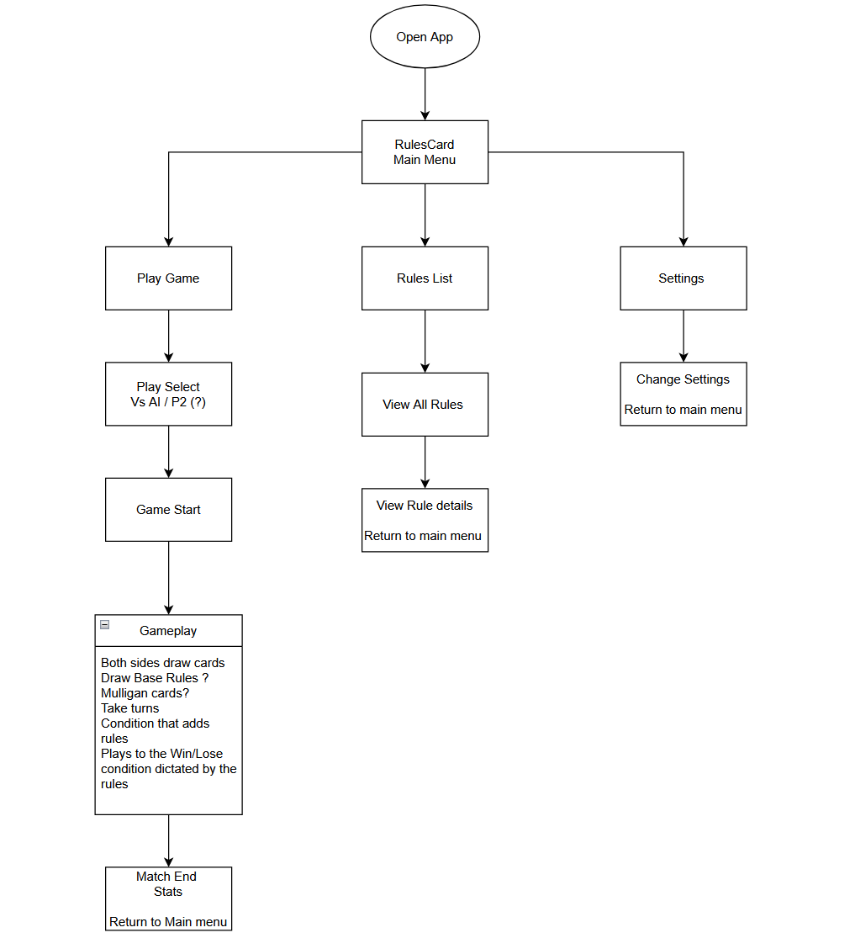
Flowchart
Suggestions -

Slide 3
Personal ideas
Present the rules as cards themselves
Have the rules list "unlock" each rule for viewing in menu after you see a rule in-game

Slide 4
Goals for Presentation
Functioning prototype of the Rulescard game.
Minimal Rule Implementation
Minimal Visual presentation
AI demo? Or Player versus Player demo?
How much of a demo would be need?

Slide 5
Next Sprint
Implement barebones UI

